Slide 1
Cheminformatics& Machine Learning in Industry
CAMLC Workshop 2025
Guilian Luchini

Slide 2



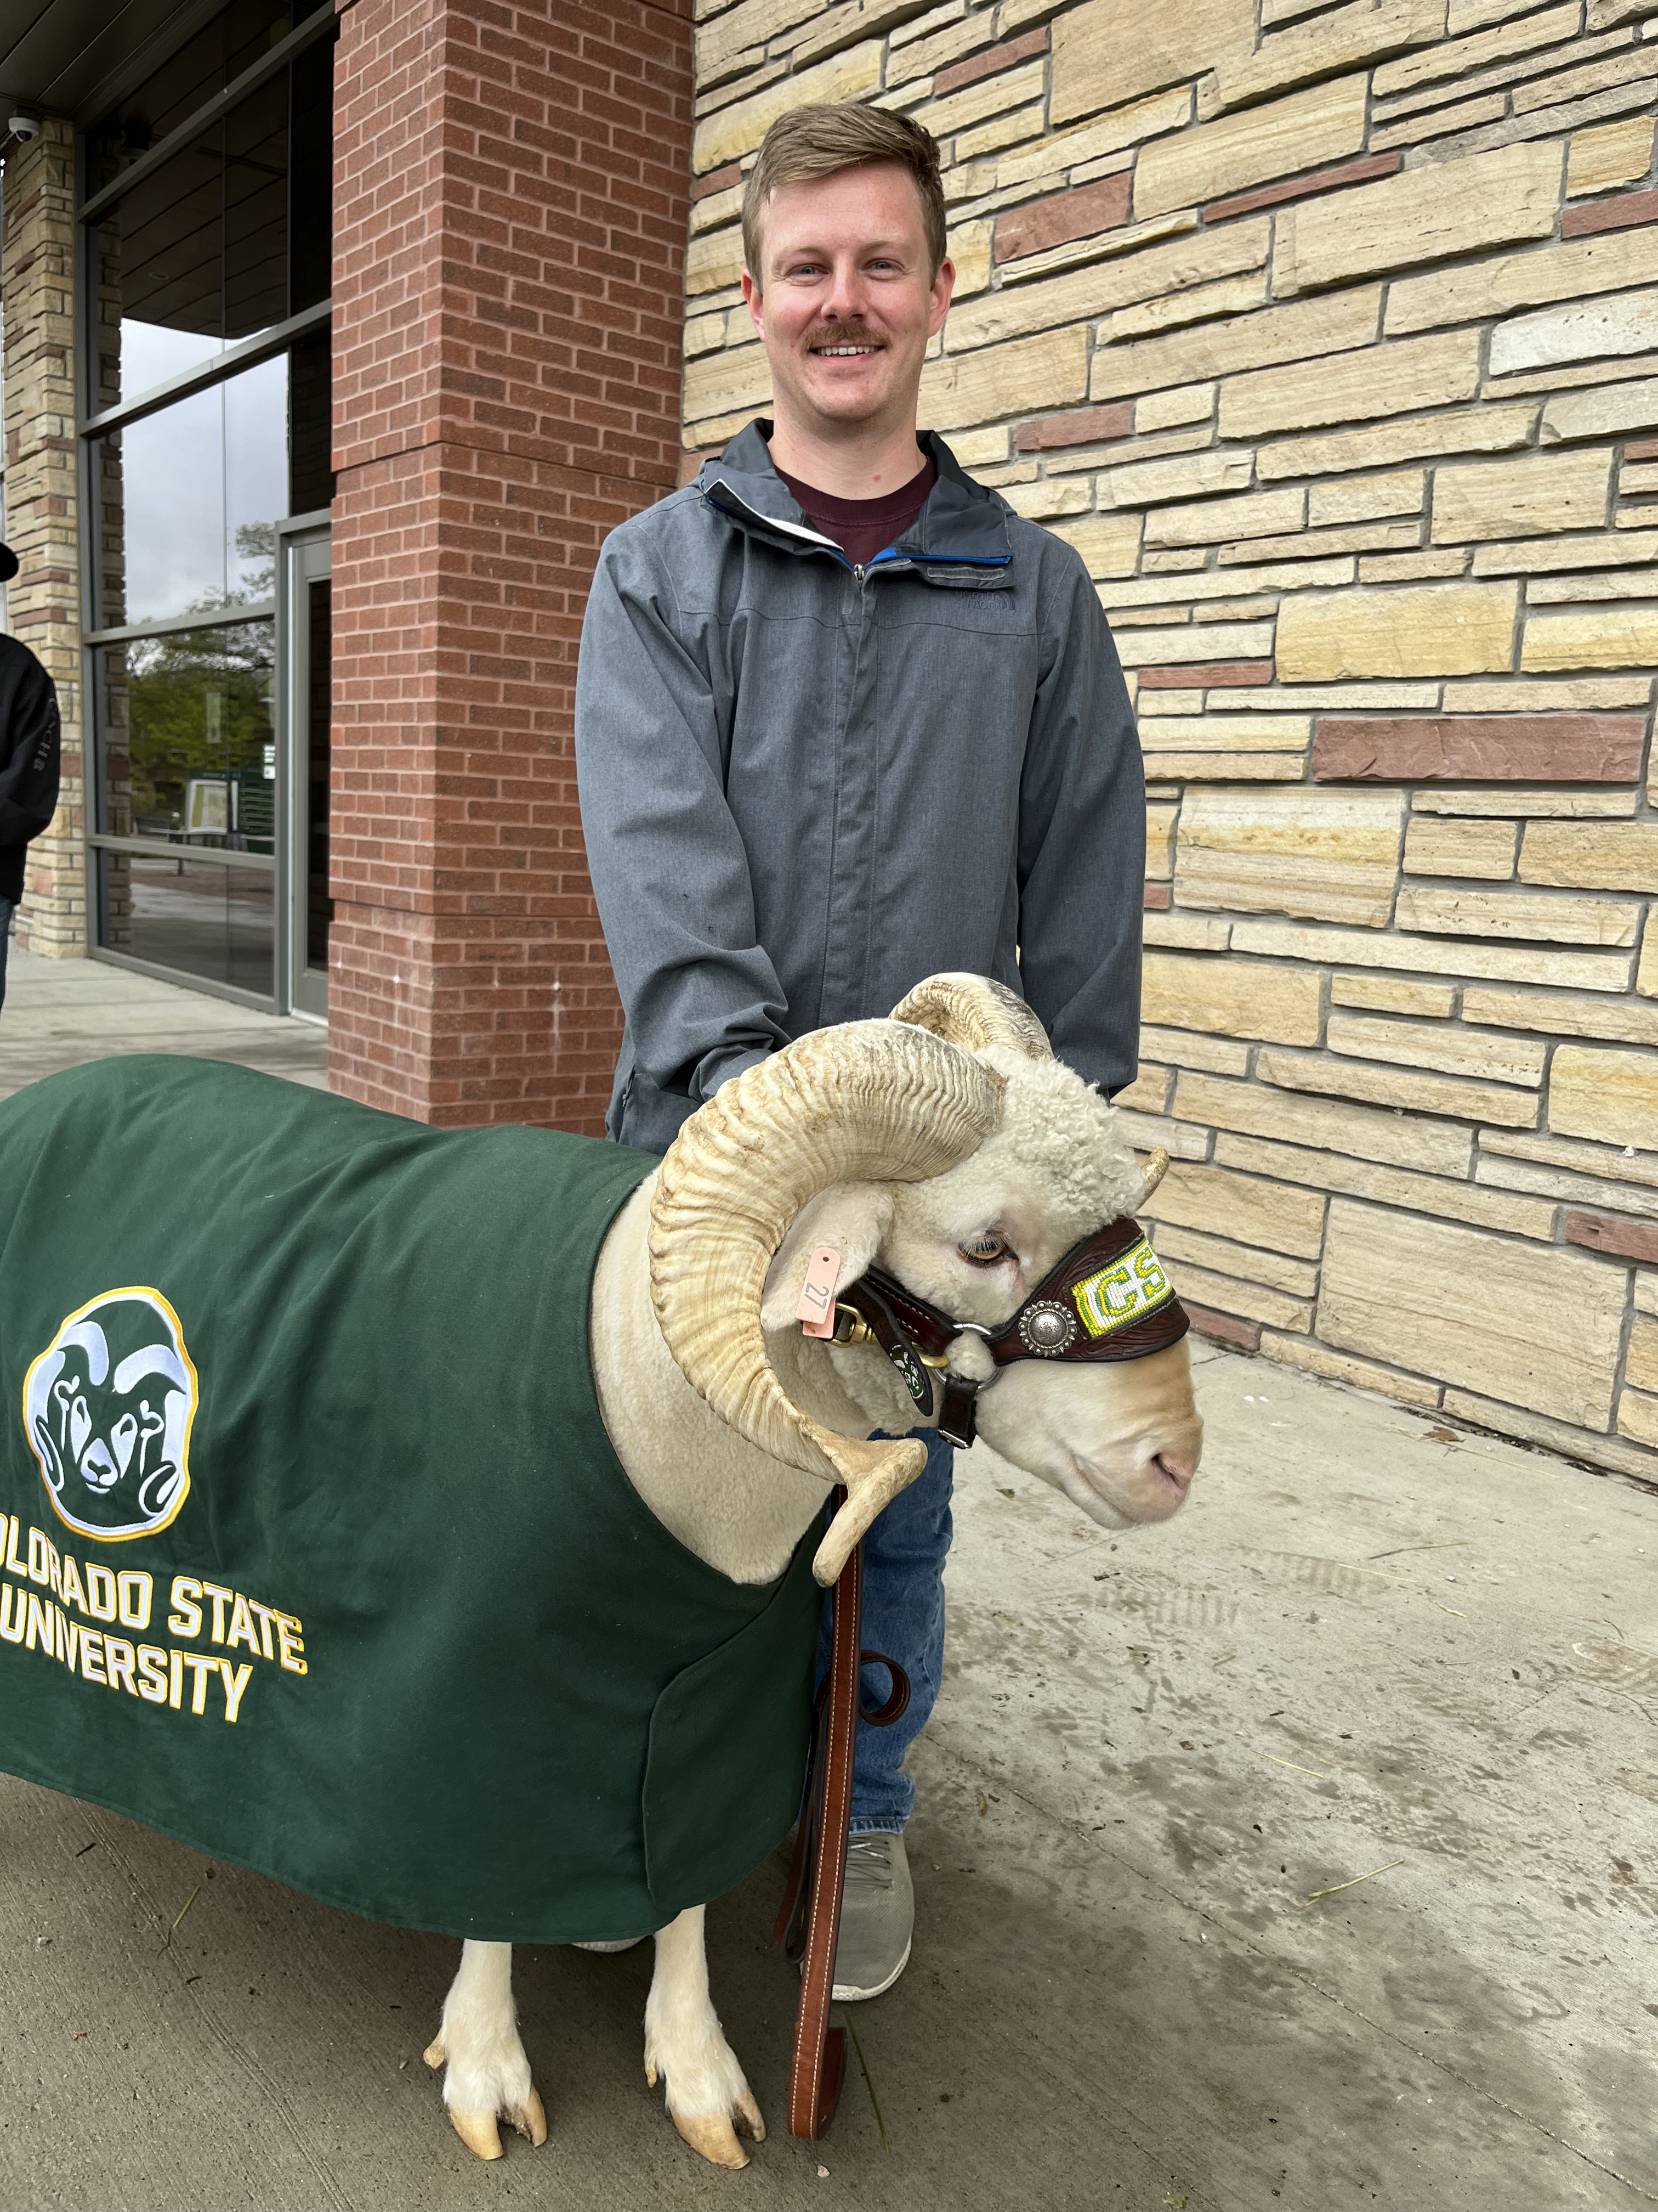
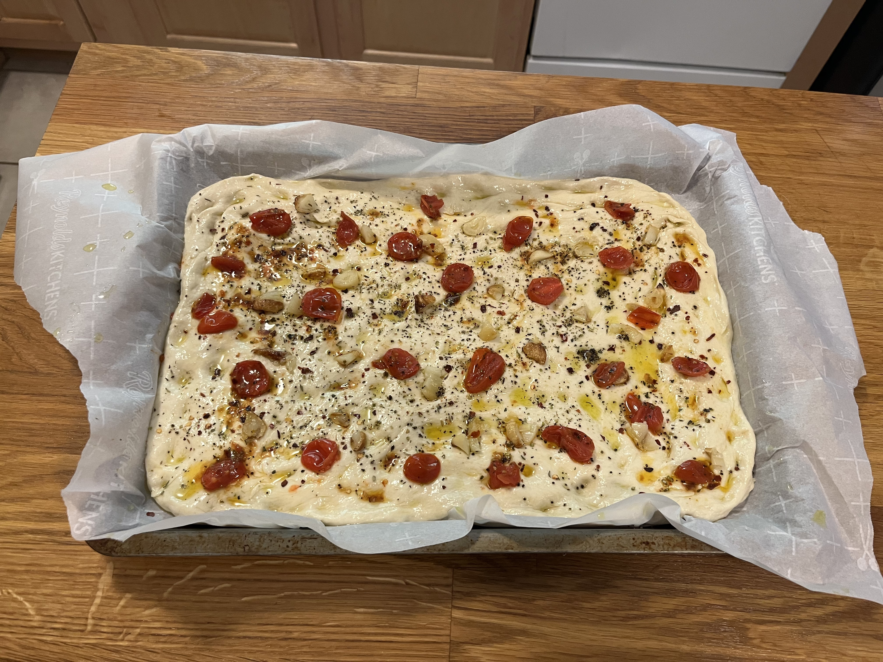
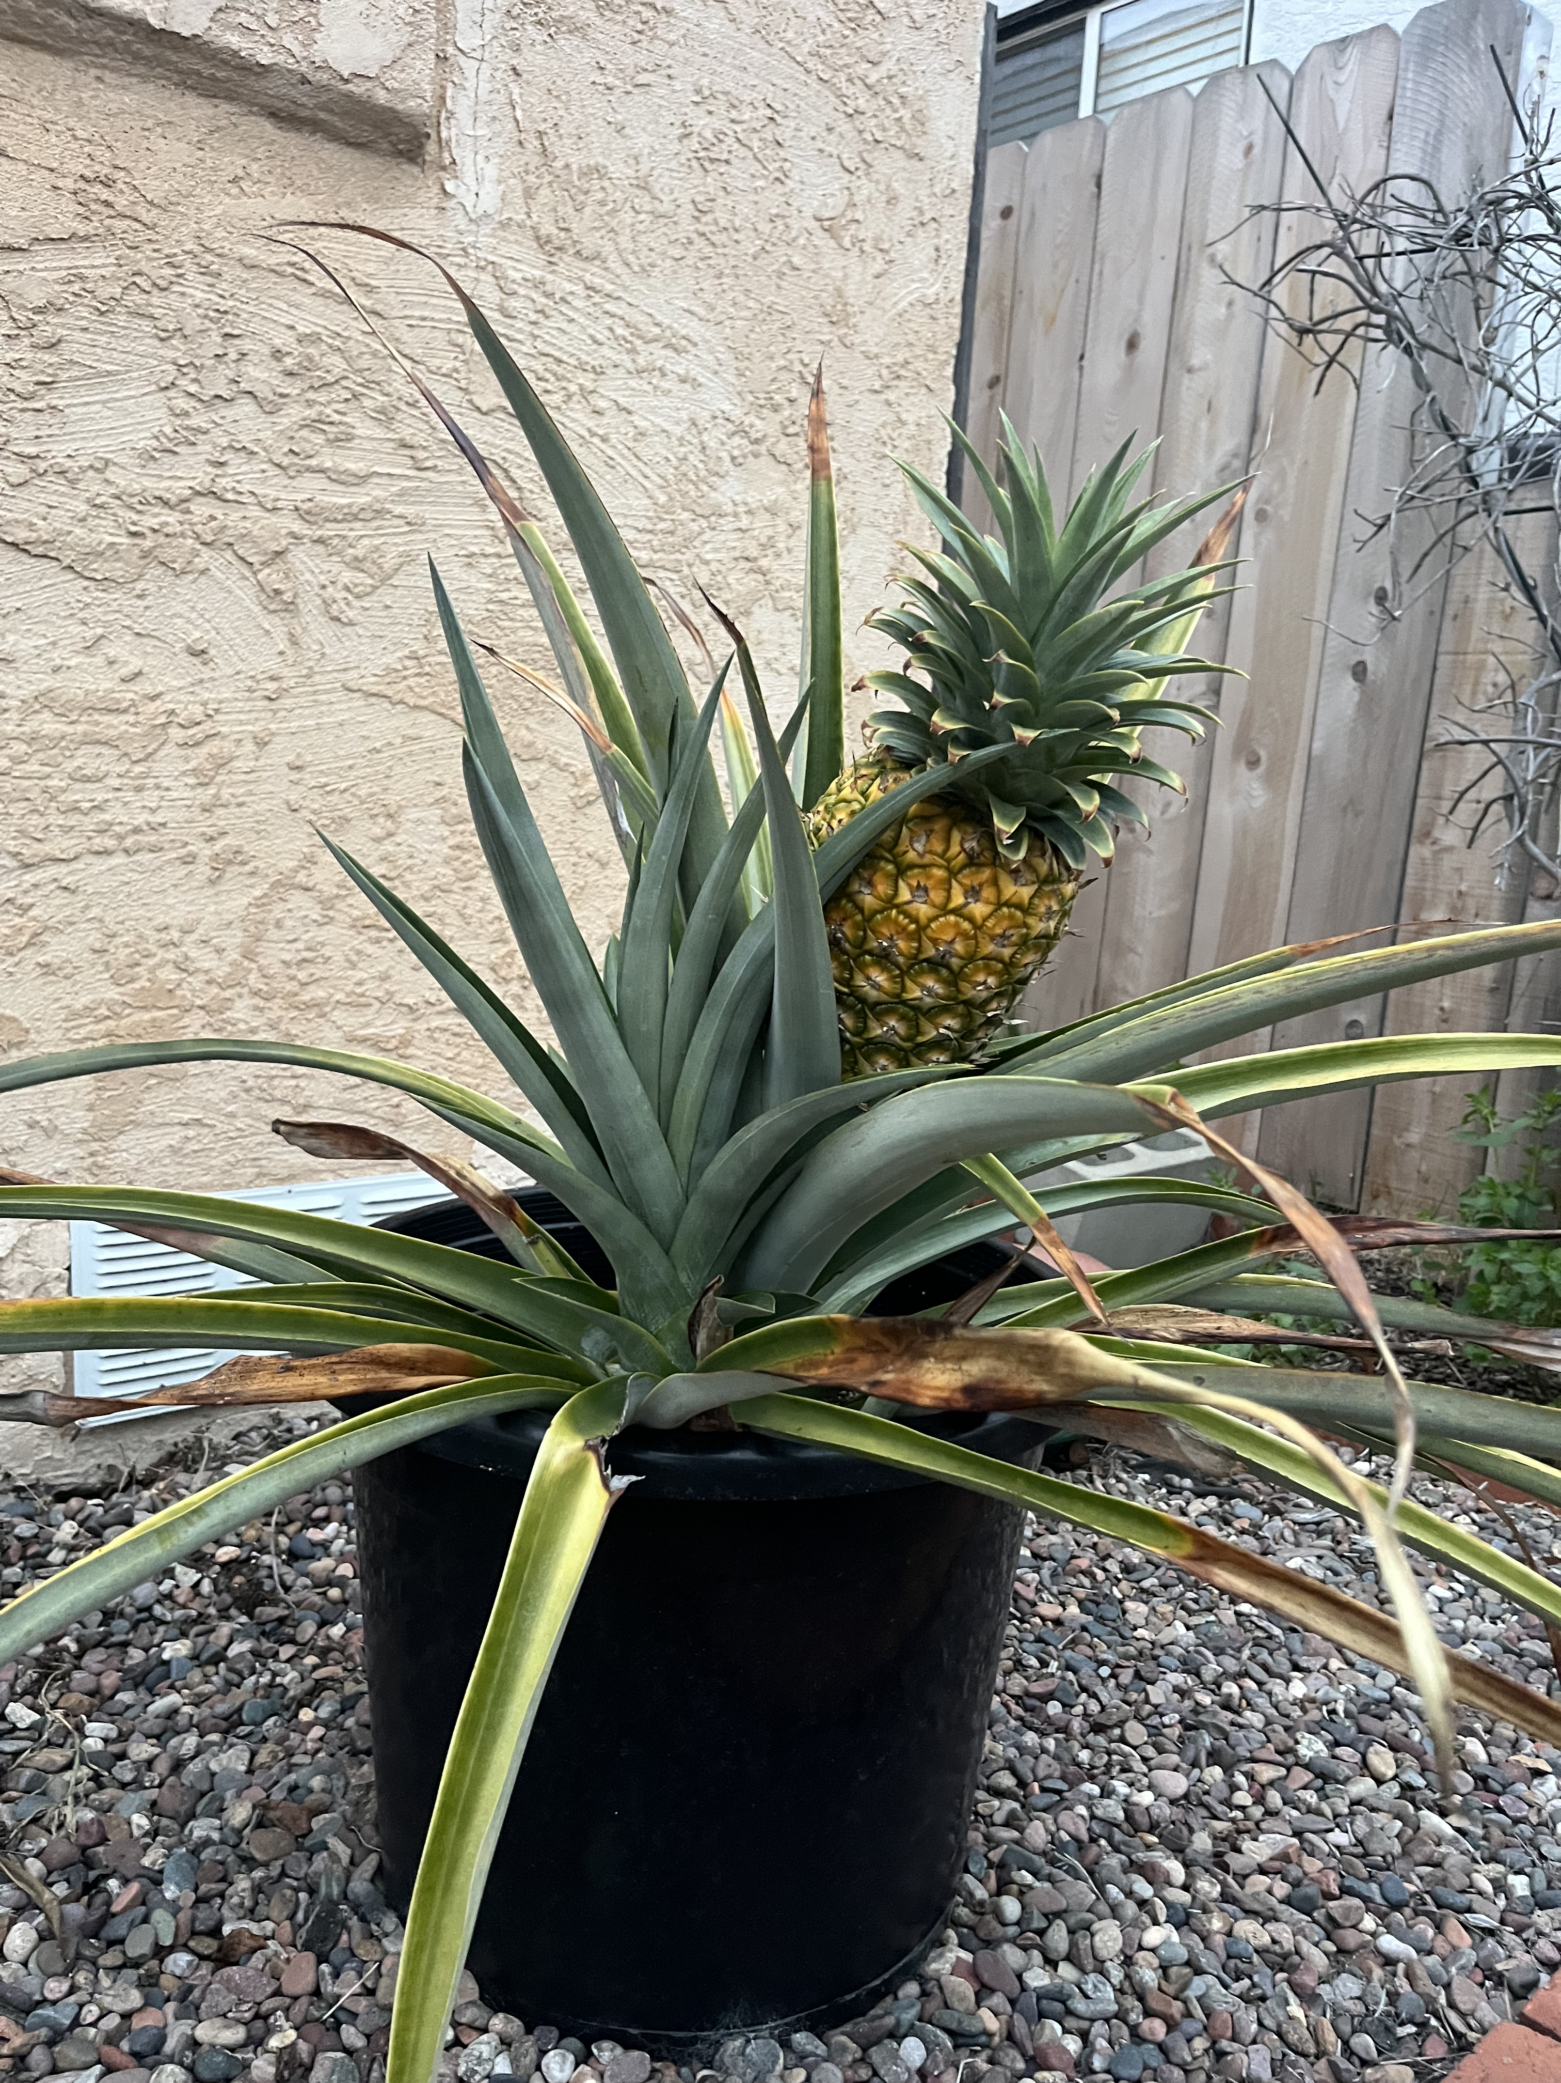

A bit about me…
BS in Chemistry from University of Portland, Portland Oregon
PhD in Chemistry from Colorado State University w. Rob Paton
Small organic molecules, DFT, Data Science
Interned at GSK in Drug Discovery
Started at BMS in 2023
Small Molecule Drug Discovery
Enjoy Camping, Hiking, Cooking, Pet Sitting

Slide 3
Outline
1. Drug Discovery Toolbox
2. Exploring Chemical Space
3. Useful Chemical Databases
4. Reaction Enumeration
5. Free Wilson Analysis

Slide 4
Drug Discovery Toolbox
Many tools are useful for understanding the SAR in drug discovery projects
Ligand-Based Drug Discovery
Semi-Empirical & QM Calculation
3D QSAR (ROCS, eSIM, RDKit)
ML Modeling
Aids in understanding ligand conformation; sterics and electronics; property space
Structure-Based Drug Discovery
Docking
Molecular Dynamics
FEP
Aids in probing ligand-protein interactions, binding affinity, target selectivity
Greater Computational Cost
Mix of Commercial and Open-Source tools

Slide 5
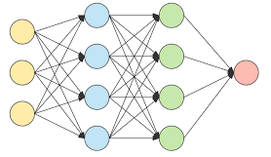
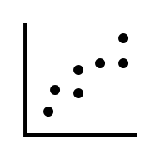

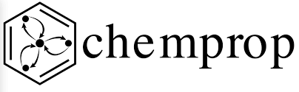


Utilizing Prediction to Accelerate Drug Discovery
If we can predict a molecules properties before synthesis, can we rule out unfavorable outcomes?
Relate computational predictions to experimental activity
Target Activity (i.e. ligand binding assay results)
Solubility, Metabolism, Toxicity
Consider:
Explainability, Domain of Applicability,
Notes:
ADME: Adsorption, Distribution, Metabolism, Execretion
Chemprop: Message Passing NN framework

Slide 6
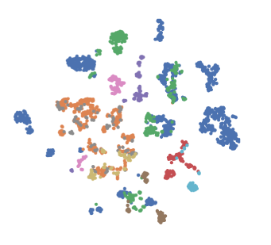
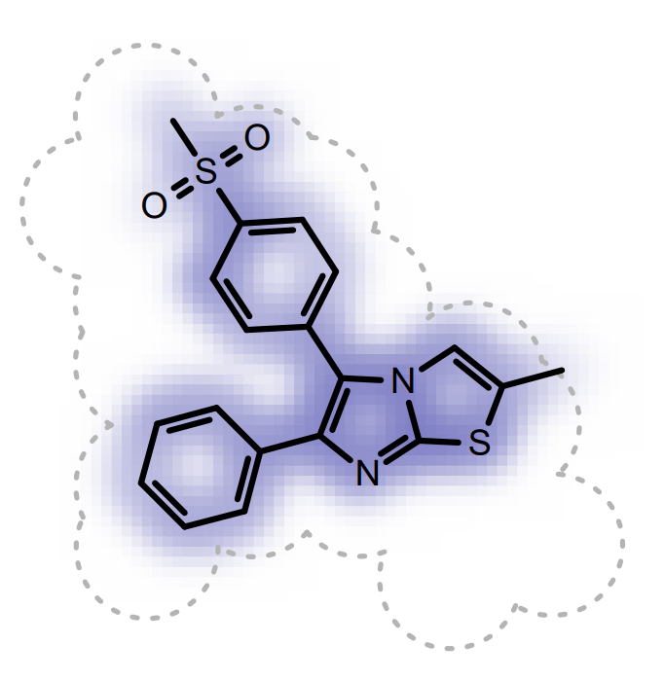

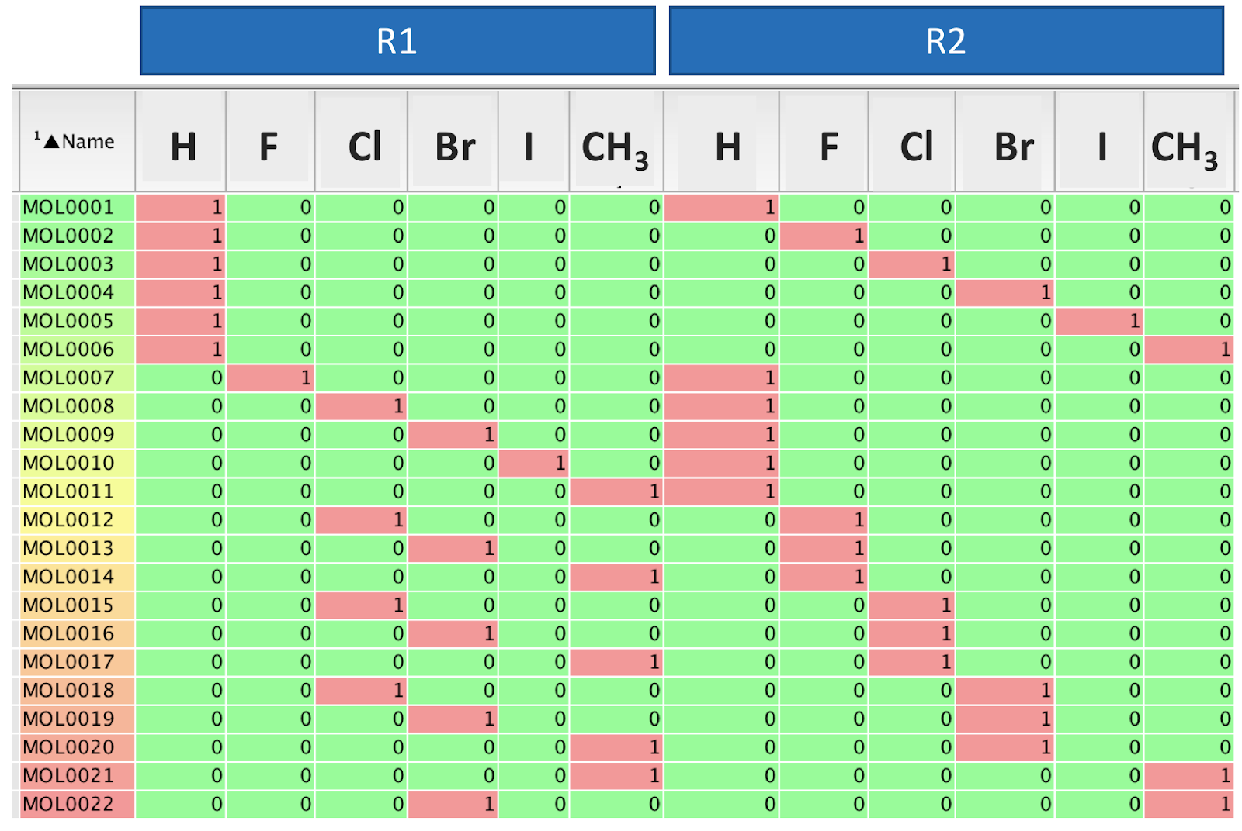
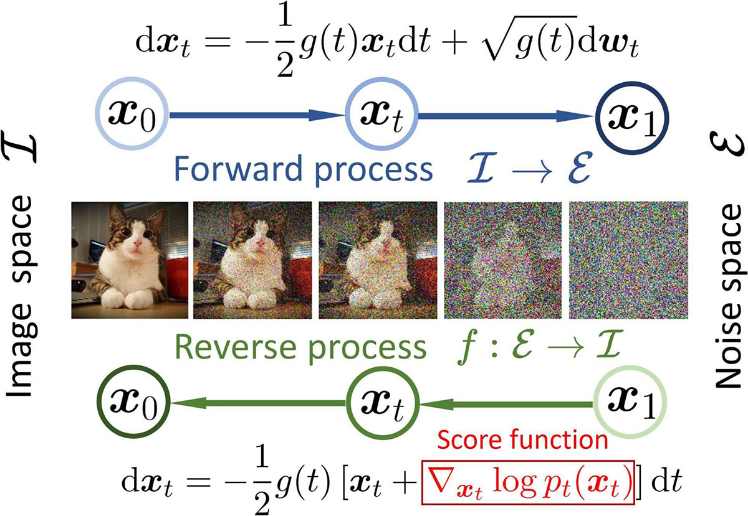
Exploring Chemical Space
2D & 3D Similarity Searches
Database & Internal Inventory
Tanimoto, 2D v 3D, Curated selection
R-Group Enumerations
Reaction-based enumeration
Tools for synthetic accessibility
Free Wilson Analyses
Guide design through missed matched pairs
Machine Learning
Reinforcement Learning/Diffusion Modeling
Axis 2
Axis 1
[c:1]C:2[O:3].[N:4]>>[c:1]C:2[N:4]
Notes:
https://doi.org/10.1038/s41467-020-16201-z
https://docs.eyesopen.com/applications/rocs/rocsreport.html
https://www.siam.org/publications/siam-news/articles/generalization-of-diffusion-models-principles-theory-and-implications/

Slide 7
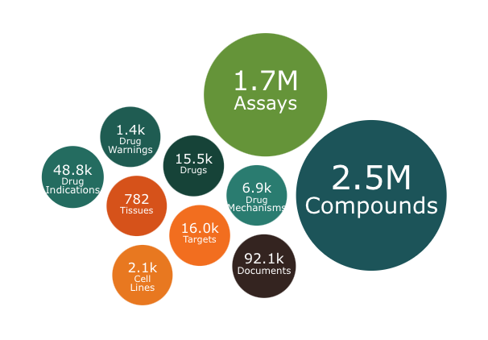
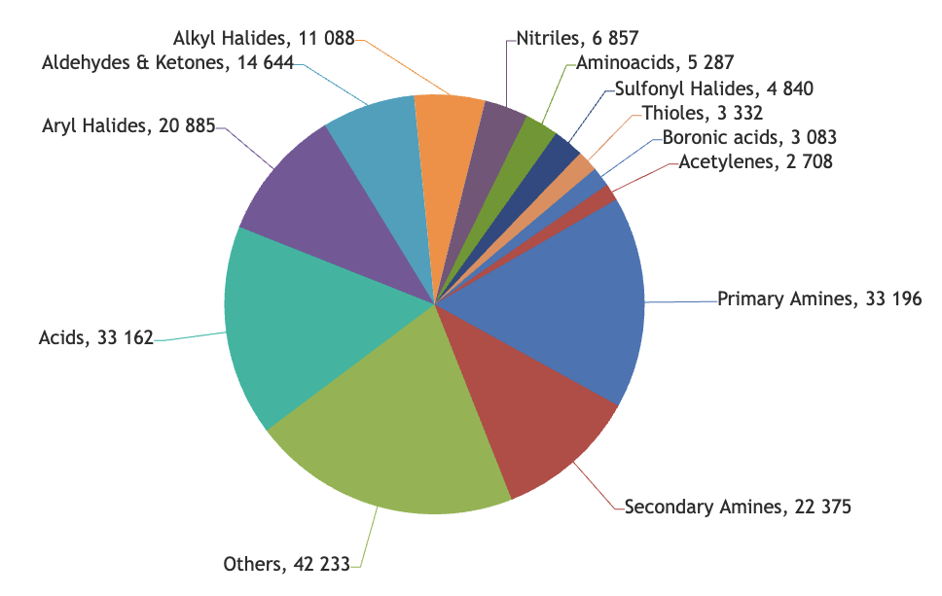
Sourcing Chemical Matter
Some common curated databases in drug discovery
ChEMBL
Reagents: Search vendor DBs by exact/substructure; filter by availability, time, cost
Scaffold hopping: Extract scaffolds/R-groups; query ChEMBL/PubChem/PDB/patents by similarity/shape/modeling; preserve key contacts; check novelty/IP.
Diversity: Mine virtual DBs with property/structural alert/synthetic accessibility filters; cluster and select diverse representatives
Data Cleaning: Standardize (salts/tautomers/stereo), deduplicate; route hits directly into enumeration or purchase.
Enamine

Slide 8
Computational Reaction Enumeration
Reaction Enumeration is Useful & Applicable when you have a defined scaffold and attachment point plus curated building blocks, and you want to systematically generate analogs via validated reaction templates/SMIRKS (e.g., amide couplings, Buchwald–Hartwig, SNAr) to map local SAR.
Scaffold with carboxylic acid attachment point
Reagent
Product
Reaction SMARTS/SMIRKS:
[c:1]C:2[O:3].[N:4]>>[c:1]C:2[N:4]
RDKit can do these transformations!

Slide 9

Scoring Reaction Enumeration Outcomes
Filter based on
Molecular Properties: MW, LogP, TPSA, HBD, HBA,
Synthetic Accessibility: SA Score, SC Score, Synformer
Modeling: Conformation, Docking Models, FEP
ML Predictions: On and Off-Target Activity, Solubility, ADME/Tox Prediction
Notes:
ADME: Adsorption, Distribution, Metabolism, Execretion

Slide 10
Free Wilson Analysis
A Free-Wilson analysis is a classical structure-activity relationship (SAR) method developed by Spencer Free and James Wilson in 1964. It's a linear additive model that decomposes molecular activity into contributions from individual substituents.
Useful & Applicable when:
You have a congeneric series sharing a common scaffold with substituents varied at defined positions, tested in the same assay and you’re willing to assume mostly additive, position-specific substituent effects.
Your library design provides coverage (multiple substituents sampled at each position and combined across positions), enabling decomposition of substituent contributions without severe collinearity or data sparsity.
You want a fast, interpretable SAR tool to guide next substitutions or enumeration; interaction effects are expected to be small, and you have enough data per substituent/position to fit a stable model.
https://practicalcheminformatics.blogspot.com/2018/05/free-wilson-analysis.html

Slide 11
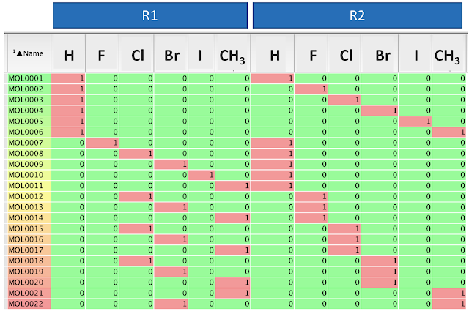
Free Wilson in Practice
One-Hot encode substituents
Build linear regression model to assess substituent effect on experimental outcome
Limitation: assumes substituents have additive effects

Slide 12
Summary
Design
Make
Test
Analyze
Use the right tool for the question; validate and iterate quickly
Explore diverse, developable chemical space. Balance novelty, shape, properties, and IP
Utilize available databases (internal + external)
Enumerate makeable reactions. Use realistic templates and applicable filters
Free–Wilson: fast, interpretable SAR guidance; beware non-additivity and sparse data

